Slide 1
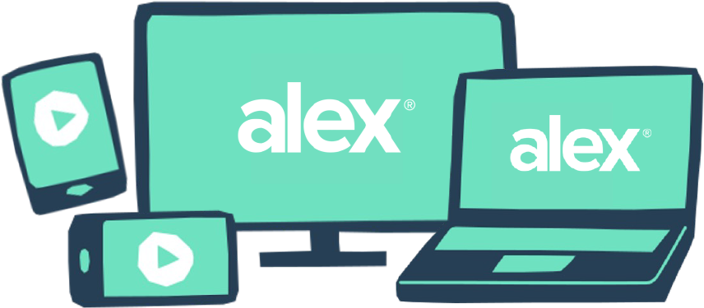
Go with confidence.
Already know how your benefits work and just want to make sure you’re still on the right plan?
ALEX Go is a text-only version of our interactive benefits tool that asks you for a few health spending estimates and then shows you your best, most affordable coverage options.
Give it a try at <www.sampleURL.com>
QR CODE HERE
YOUR LOGO HERE

