Slide 1
Notes:
{INTRODUCTION}
We want all our employees to find the benefits that are going to make them the most happy, which is why want you to know about ALEX, our virtual benefits counselor.
OR
This year, to help everyone find the benefits that are going to make them the most happy, we're offering a virtual benefits counselor called ALEX.
ALEX can help you find the medical plan <AND DENTAL AND VISION> that will work best for your needs and budget, and explain how everything works in language you can understand.

Slide 2
Who is ALEX?
ALEX is an interactive guide who explains your benefits options, and helps you choose and use what’s best for you.
Notes:
ALEX is an interactive, online tool that works on any computer, tablet, or smartphone.
It’s an expert on <COMPANY NAME> benefits, and using it can help you pick benefits that provide the right level of coverage for your needs without taking too much money out of your paycheck.
ALEX works like this…

Slide 3
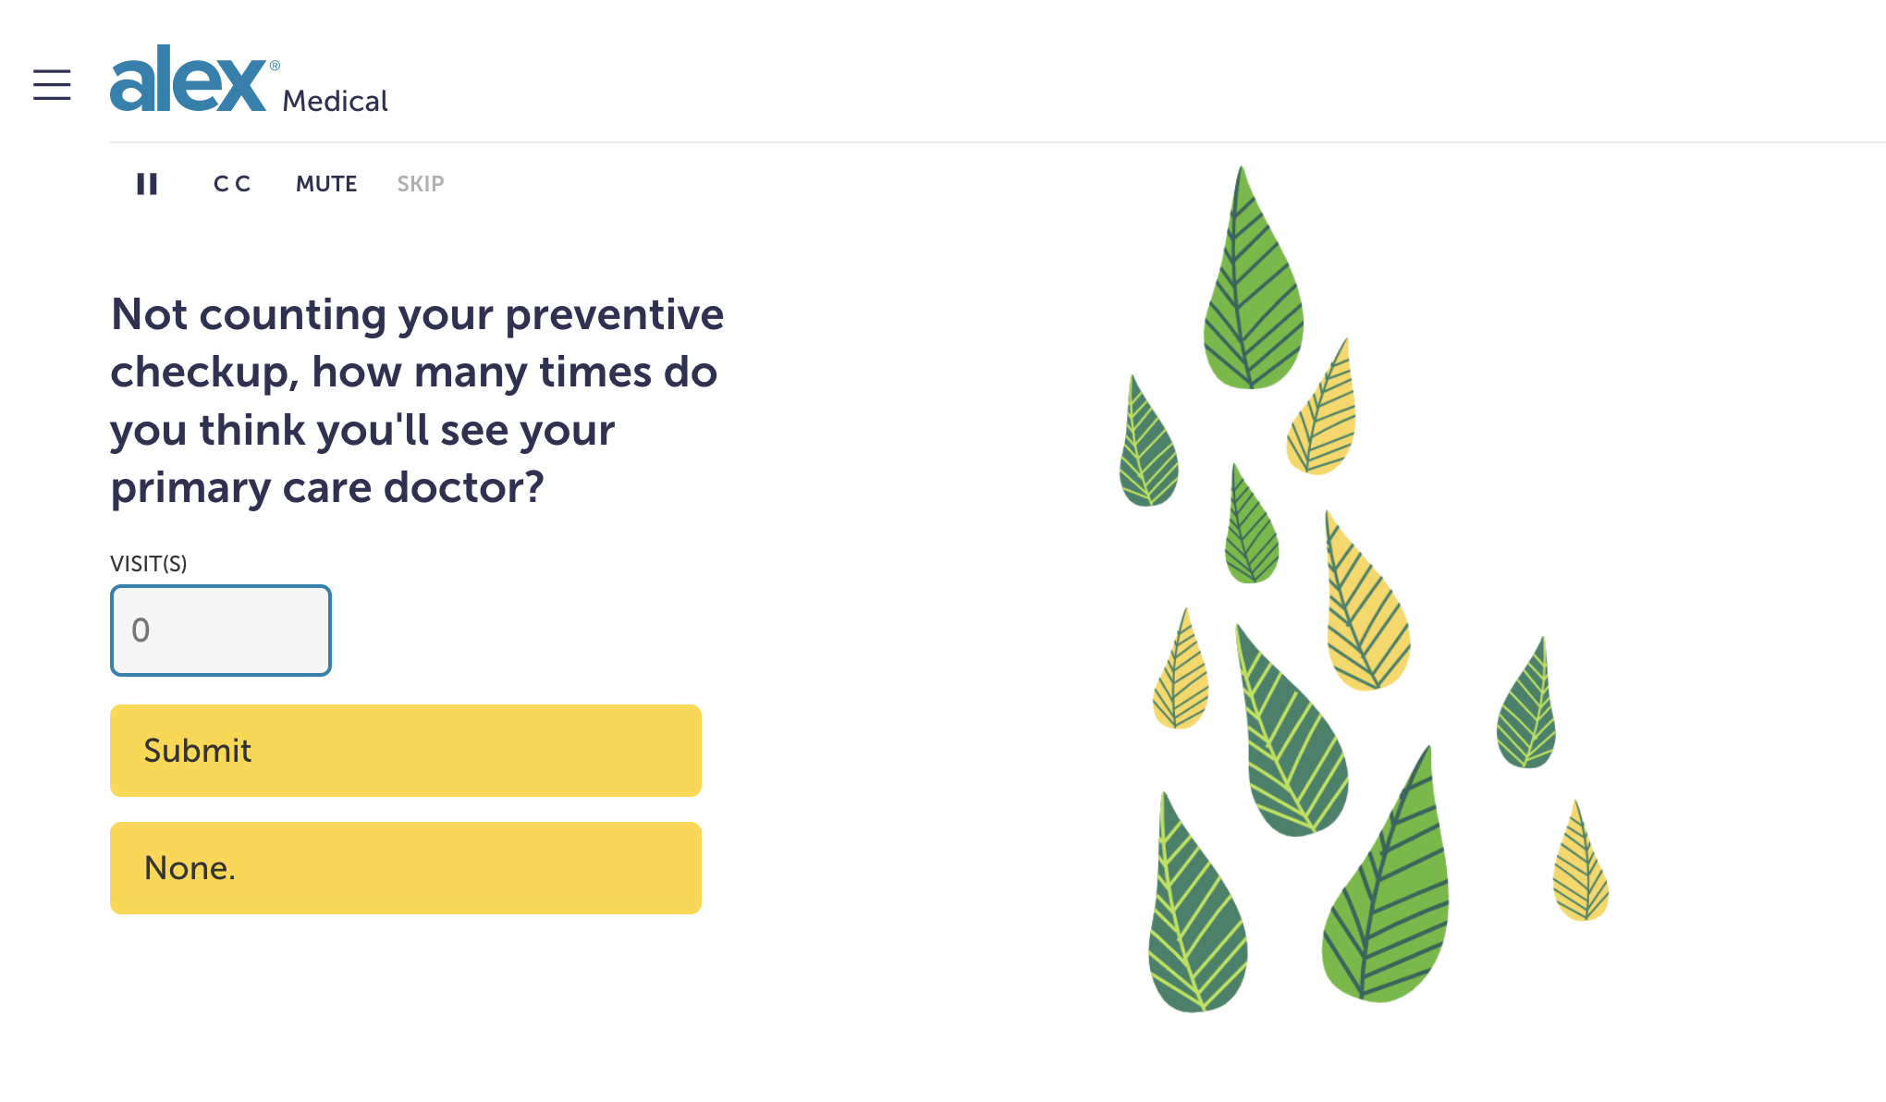
ALEX will ask you a few questions about your personal situation.
Remember- this is completely anonymous
Notes:
First, ALEX will ask some questions about your personal situation so it can better understand your needs.
(Don’t worry—everything you share with ALEX is completely anonymous)

Slide 4
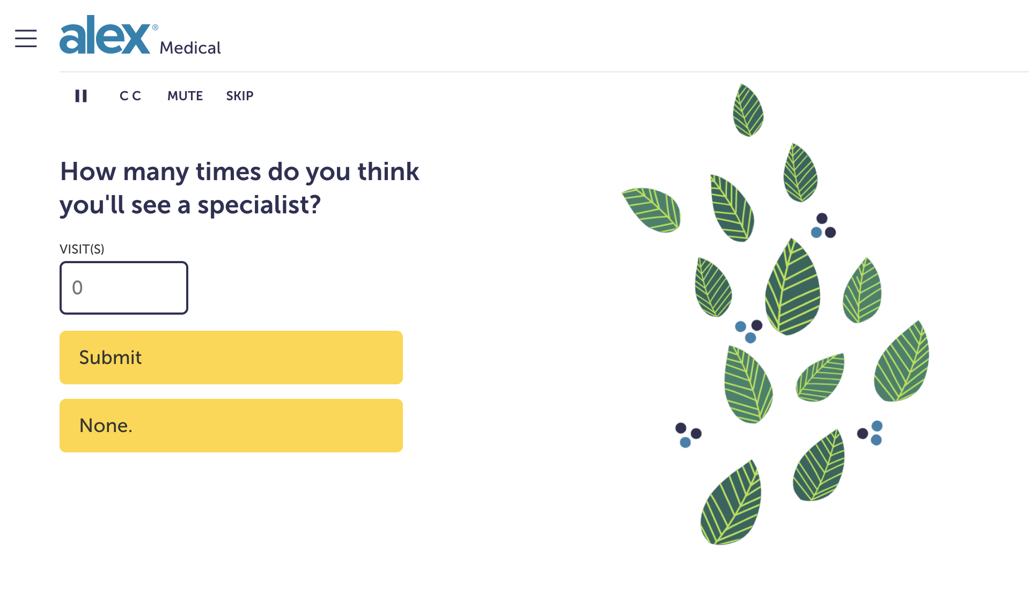
ALEX will ask you a few questions about your personal situation.
Remember- this is completely anonymous
Notes:
First, ALEX will ask some questions about your personal situation so it can better understand your needs.
(Don’t worry—everything you share with ALEX is completely anonymous)

Slide 5
And come up with a plan recommendation just for you.
Notes:
And then you’ll be matched with the plan options that fit you best.
(Of course, you can also see why ALEX thinks its recommended plan is better than your other options)

Slide 6
Find Your Benefit Bliss with ALEX
Personalized
Easy to Use
Confidential
Talk to ALEX® on whatever you like.
<sampleURL.com>
Notes:
{BULLET POINT WALKTHROUGH}
Here’s three important things to know about the ALEX tool:
1. ALEX is personalized, which means it can help you see which plan makes the most sense for YOU, not your coworkers, or your boss, or even me, your charming benefits genius.
2. ALEX is easy to use. The tool doesn't ask for a username or password. You just click the link from any computer, tablet, or smartphone, and go. Also, ALEX is completely free of boring insurance jargon and complicated legal jibber-jabber.
3. ALEX is confidential. While it does ask questions about your personal situation to understand your needs, your answers are completely confidential, and nothing you share with the tool will ever be recorded or shared.
---
{URL OUTRO}
The link to ALEX is right here, and you can also find it at <YOUR PORTAL, EMAILS YOU MAY HAVE SENT, OTHER LOCATIONS, ETC.>.
Remember, ALEX works on any computer, tablet, or smartphone, so you can discover your lowest-cost, best-coverage ben

