Slide 1
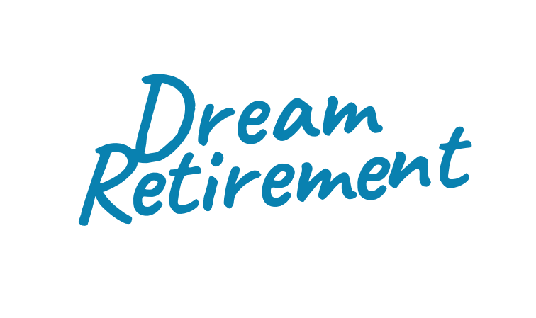
Will you need more than the match to retire?
Taking advantage of our 401(k) match is a smart first step towards a comfortable future. But you’re much more likely to retire on schedule if you contribute even more.
To figure out the right amount to save this year, talk to ALEX at sampleURL.com today.
YOUR LOGO HERE

