Slide 1
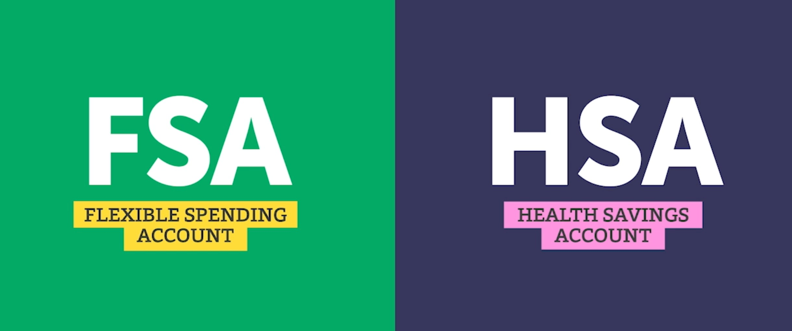
HSA or FSA? What’s the difference?
Do you know the difference between a Flexible Spending Account and a Health Savings Account? If not, I don’t blame you. But there are a few key differences you should be aware of. ALEX has info on FSAs vs. HSAs that could help you out.
sampleURL.com
YOUR LOGO HERE

