Slide 1
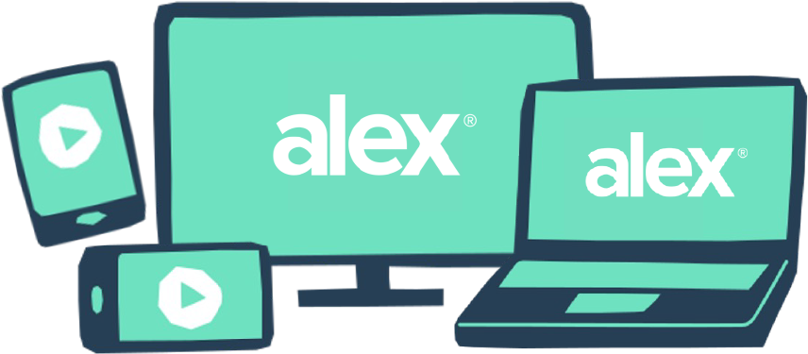
BENEFITS QUESTION?
Ask Chat first.
Chat, our benefits chatbot powered by ALEX, is available 24/7 to give you instant answers to all your burning benefits questions.
CHAT IS GREAT FOR:
NOT SURE WHAT TO ASK?
Looking up plan details
Tracking down account links
Decoding benefits jargon
Quick questions after hours (even when the rest of your benefits team is sleeping)
Start with one of these common questions:
What’s my deductible?
How is mental health covered?
How do I find an in-network doctor?
How do I contact HR?
What is my EAP?
How do I contribute to my 401k?
QR CODE HERE
Try it now at <sampleURL.com>
YOUR LOGO HERE

