Slide 1
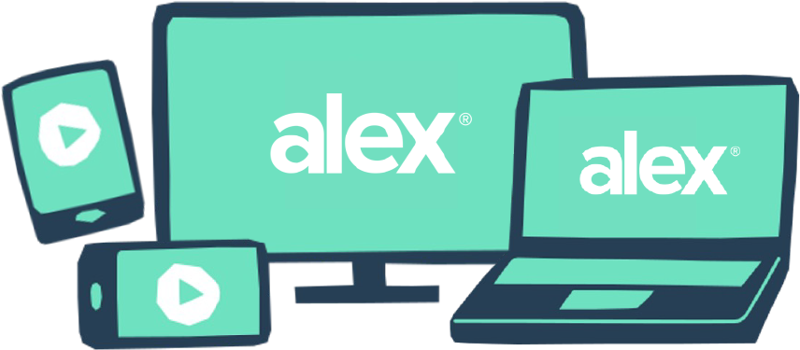
Make better benefits choices with ALEX.
Because you shouldn’t need a PhD to pick a health plan.
86% OF EMPLOYEES
ALEX is an interactive online experience designed to help you make confident choices about your benefits during enrollment. Just answer a few questions about your preferences and health care needs, and ALEX can narrow it down to only show you plan options that give you the best coverage for the lowest cost.
say that ALEX gave them a better understanding of their benefits
FAST & FRIENDLY
EMPLOYEES WHO TALK TO ALEX SAVE
Using ALEX is sort of like chatting with a smart, funny friend (who happens to have memorized all of your employer’s plan documents). In less than 15 minutes, you’ll create a plan of action you can use to speed through enrollment.
18%
TOTALLY CONFIDENTIAL
more in their HSAs than the national average
ALEX is available to chat any time, day or night, at work or at home. Your responses are totally private and won’t be shared with your employer, so you can explore freely.
31%
SMARTER THAN EVER
more in their 401(k)s than the national average
ALEX has a new decision-making engine under the hood that harnesses the power of AI to analyze your responses and make sure suggested plans fit your risk tolerance, financial situation, and have been proven to work for others like you.
Try it now at <sampleURL.com>
QR CODE HERE
YOUR LOGO HERE

