Slide 1
Onboarding Toolkit
Introductions to you and your benefits.
ONBOARDING 2023

Slide 2
Onboarding Toolkit
01
Onboarding Timeline
02
New Hire Sneak Peek
03
Email Templates
04
Onboarding Collateral

Slide 3
EVEN BEFORE THE FIRST DAY
In the beginning
Onboarding a new team member begins long before their first day. Make sure you’re setting them up for success by connecting them with their benefits!
Send a congratulatory email – include things like the New Hire Sneak Peek video
Ship a care package – everyone loves swag!
Work closely with IT to provide access to resources and tools needed to choose benefits and make important elections
Share employee benefits early!

Slide 4
THE EARLY DAYS
Give employees one-on-one benefits support
Give your new hires access to ALEX right away. The highly personalized benefits experience can go a long way in helping new hires feel supported—and it’ll set them up for success so that they’ll stay longer at your company.
Think about how to spread your onboarding program over a new hire’s first week. Cover only the most important points on the first day, such as team meetings and company overviews (including benefits).
Save meetings with other departments, training on non-critical IT systems, and other presentations for later in the week. Consider recorded videos, online scavenger hunts, and quizzes to break up the monotony of meetings.

Slide 5
The first 30 days are critical
HR teams should also check in frequently. Meeting regularly with new hires has a twofold benefit: It makes sure new employees are making progress in their job, and it allows HR teams to gain instant feedback on how well the virtual onboarding process is working. As with check-ins for employees based in the office, share an agenda in advance, stick to it, focus on development and performance, and correct any problems ASAP.
58%
Employees who go through a structured onboarding are more likely stay for three years or more!
Source: SHRM.org

Slide 6
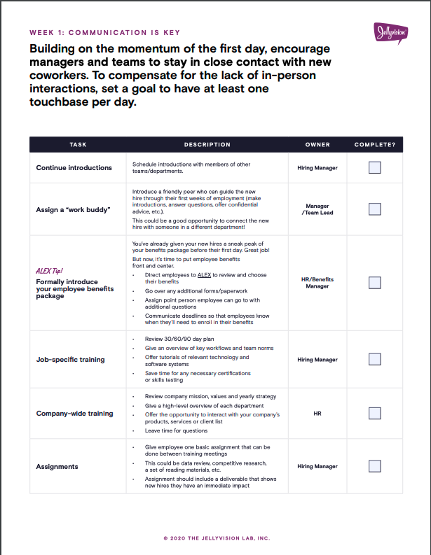
A helpful checklist
Want even more step-by-step guidance? Check out the Jellyvision Ultimate Virtual Onboarding Checklist.

Slide 7
ONBOARDING, NOW WITH VIDEO
Use the New Hire Benefits Sneak Peek!
Two weeks to go It’s crunch time!
Mail physical cards
Send an open enrollment email with all the details and important dates
Conduct a company-wide meeting
Make materials available - like the FAQ and provider contacts

Slide 8
ONBOARDING TOOLKIT
Email Templates
Grab all the email templates on ALEX Central
And if you’d like some help, our Custom Solutions team can help you with all of your email and texting goals!
A few things to keep in mind
Write without jargon. Think of how you talk to your people and write emails in a similar manner.
Keep ‘em short! Emails are more likely to be read when you keep it short.
Texts are great for employees not in front of a desk. Try something new!

Slide 9
ONBOARDING TOOLKIT
More collateral for you to share
Grab all the email templates on ALEX Central
And if you’d like some help, our Custom Solutions team can help you with all of your email and texting goals!
A few things to keep in mind
Write without jargon. Think of how you talk to your people and write emails in a similar manner.
Keep ‘em short! Emails are more likely to be read when you keep it short.
Texts are great for employees not in front of a desk. Try something new!

