Slide 1
Open Enrollment Toolkit
Let’s talk benefits.
OPEN ENROLLMENT 2023

Slide 2
Open Enrollment Toolkit
01
Open Enrollment Calendar
02
Email Templates
03
Meeting Plans
04
Post OE Satisfaction Survey

Slide 3
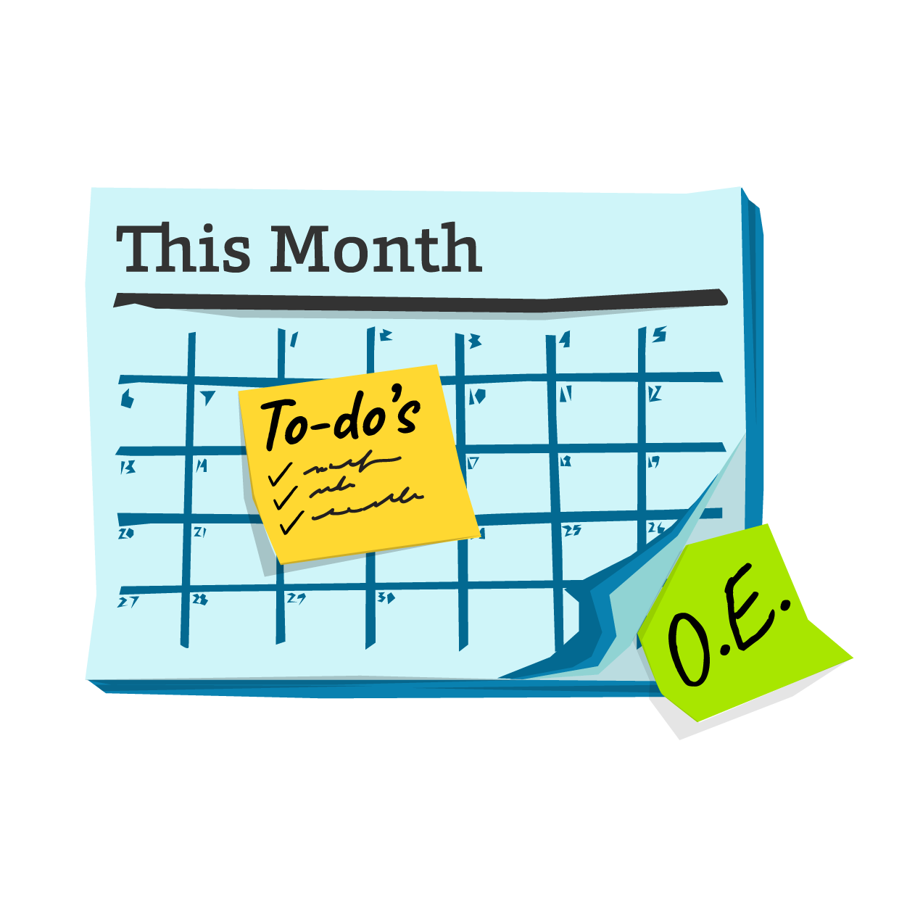
OPEN ENROLLMENT TOOLKIT
Open Enrollment Calendar
You’re here. We’re here. It’s time to get ready for Open Enrollment!
8-12 weeks before Meet your employees where they live! And that probably means on their digital devices.
Embrace virtual
Update your benefits guide
Review last year’s materials

Slide 4
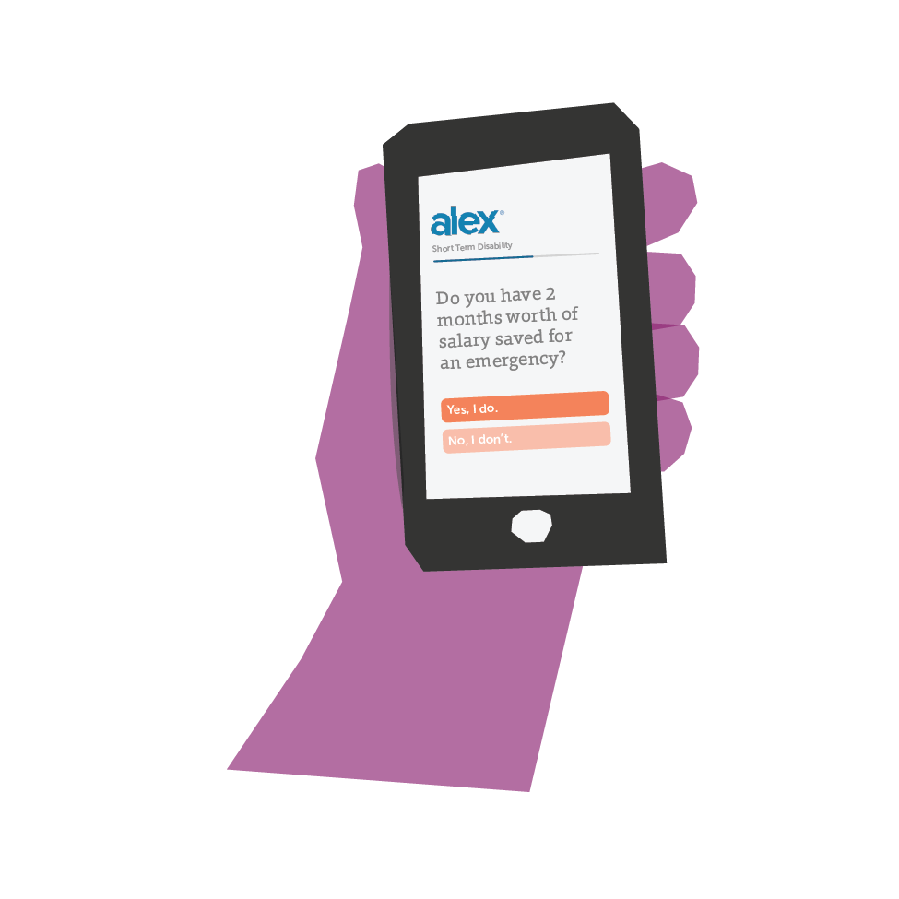
OPEN ENROLLMENT TOOLKIT
Open Enrollment Calendar
We’re so close!
4 weeks before Meet your employees where they live! And that probably means on their digital devices.
Publish intranet ads
Promote everywhere
Equip managers and leaders

Slide 5
OPEN ENROLLMENT TOOLKIT
Open Enrollment Calendar
Two weeks to go It’s crunch time!
Mail physical cards
Send an open enrollment email with all the details and important dates
Conduct a company-wide meeting
Make materials available - like the FAQ and provider contacts

Slide 6
Communications Timeline
OE Start | Day 3 | Day 7 | Last Day | 3 Days Post
Announcement Email
Send a quick text!
Email those who haven’t enrolled
Remind the stragglers!
Post OE Survey

Slide 7
OPEN ENROLLMENT TOOLKIT
Email Templates
Grab all the email templates on ALEX Central
And if you’d like some help, our Custom Solutions team can help you with all of your email and texting goals!
A few things to keep in mind
Write without jargon. Think of how you talk to your people and write emails in a similar manner.
Keep ‘em short! Emails are more likely to be read when you keep it short.
Texts are great for employees not in front of a desk. Try something new!

Slide 8
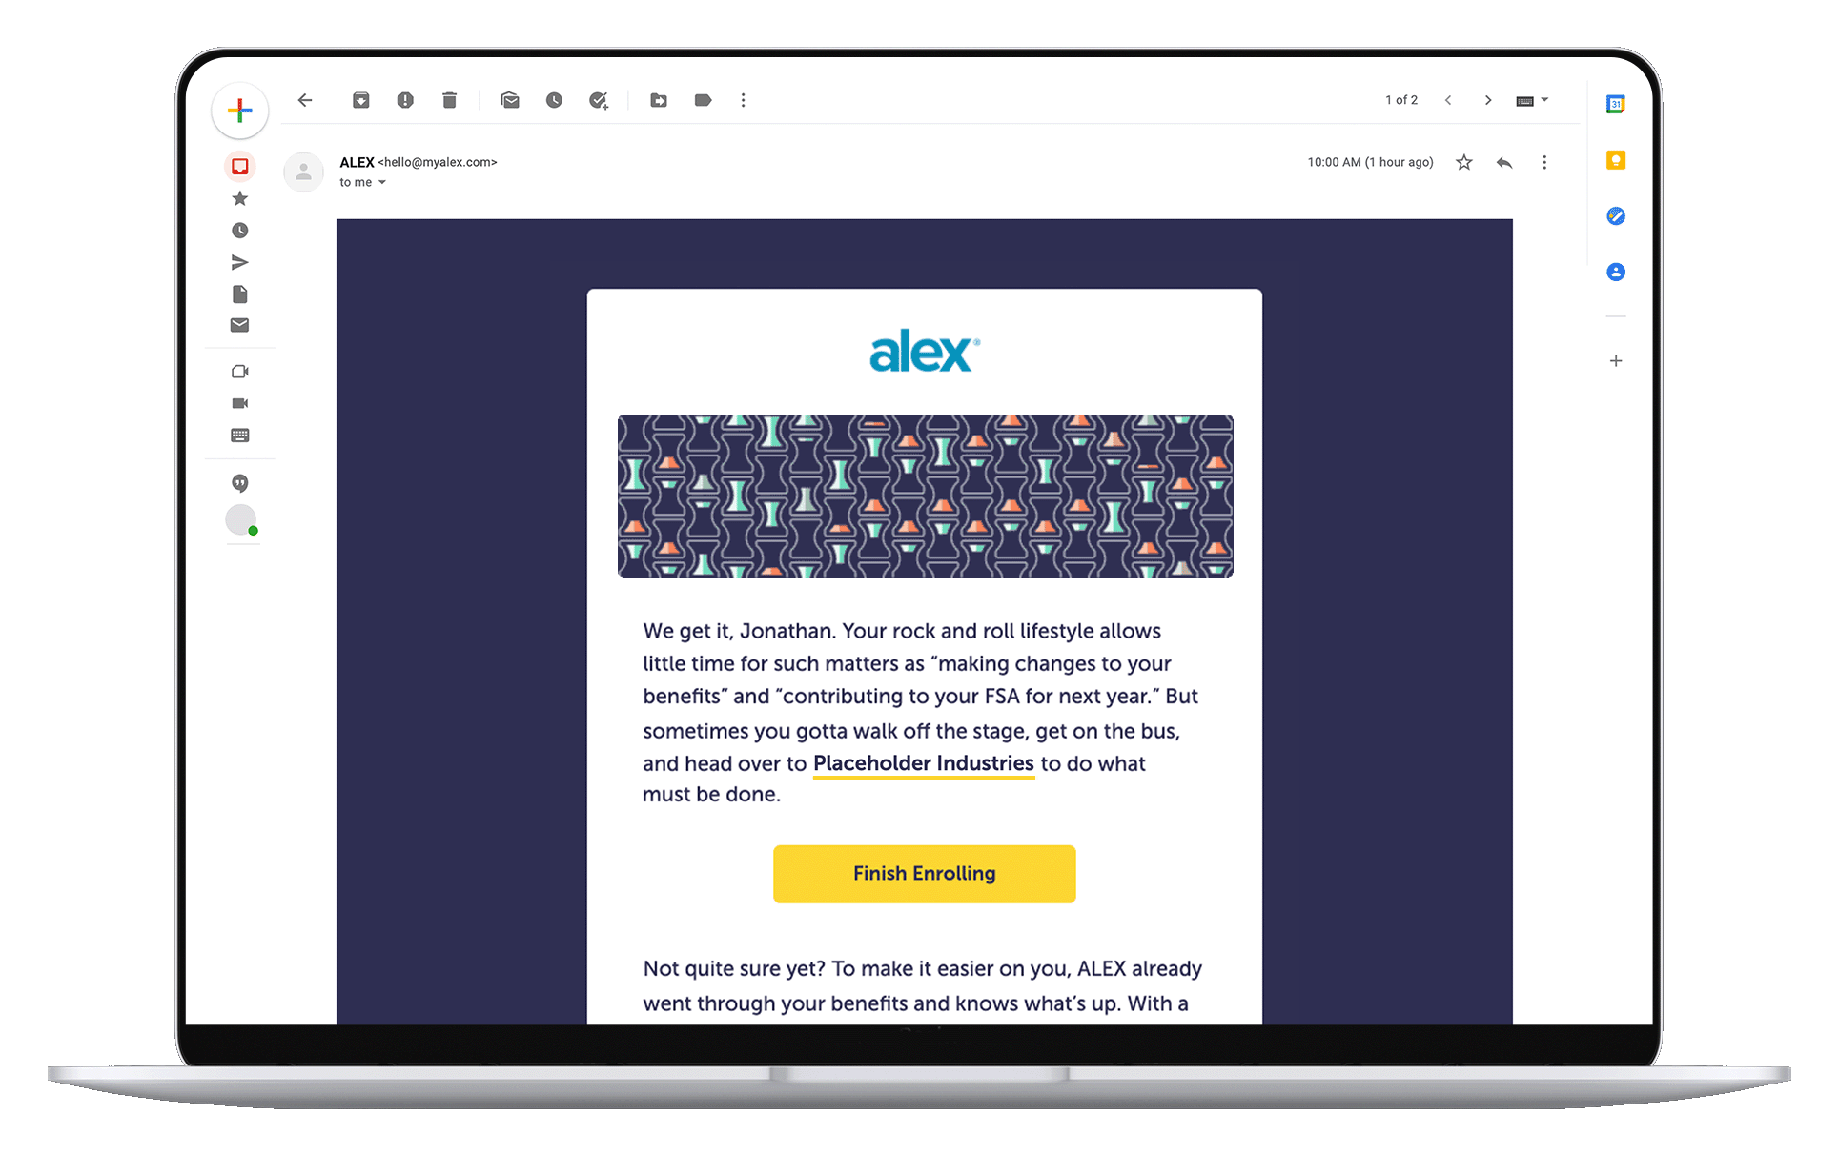
SEND SHORTER EMAILS
Increase the effectiveness of your messages with succinct emails.
Think five to seven sentences - and that’s it!
Clear call to action
Use a nurture! Nurture email campaigns have a 4-10x better response rate than stand-alone blast emails

Slide 9
Let’s sprinkle some marketing magic on a typical benefits email.
SEND SHORTER EMAILS
Dear Employee,
Our Insurance open enrollment period for the 2023 year will begin on October 1, 2022. This email is the first step of a three-part process. The information below covers what open enrollment is and what you may do during this time. Please review the information carefully.
Reasons for Open enrollment:
The Patient Protection and Affordable Care Act require employers to establish specific open enrollment periods for their employees so that required documents can be provided to the employees at the beginning of the set period.
Hi Jane -
It’s insurance time again. Between October 1, 2022 and October 15, 2023, you’ll need to choose your benefits for the next calendar year. It’s not a one-step process, but we’re here to guide you through your options so you make the best choices to protect your health and your wallet. In the coming weeks, I’ll be sending you some information that will help you make those decisions (and you can get a head start by using ALEX Benefits Counselor or visiting our online portal). Stay tuned!
Personalized
What’s in it for me
Actionable

Slide 10
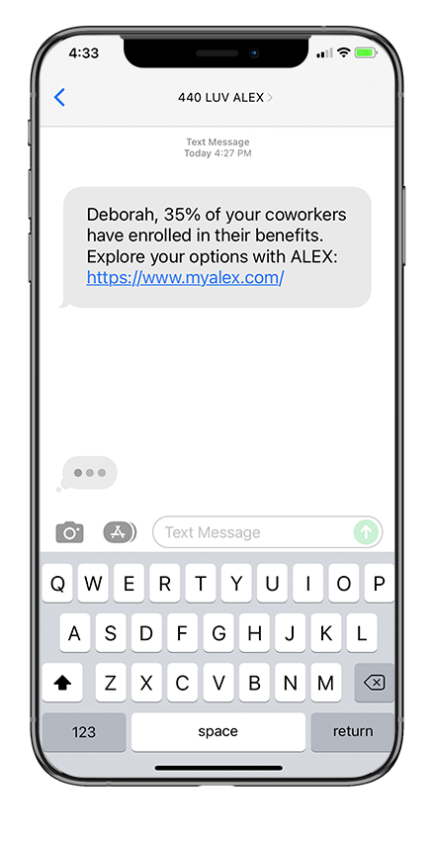
IT’S TIME TO START TEXTING
What does a good text look like?
Keep it short. The best performing texts are under 140 characters in length.
Link to more resources.
Include a call to action.
Add a bit of social proof.
Notes:
KELLY: So Chrissy, what does a good text to your employees look like?
CHRISSY:
1. Theme of the day: keep it short. The best-performing texts are under 140 characters long.
2. And because you’re keeping it short…always feel free to link out to other resources, where employees can get more in-depth information.
3. Throwing a little marketing lingo at you…include a call to action. Ideally, your text should tell employees to do something — visit your benefits engagement platform, complete their enrollment, sign up for a new benefit, etc.
4. And lastly, add a bit of social proof. That can be testimonials or stats about how other employees are using their benefits. As you can see in the text examples here, we’re calling out that “35% of your coworkers have already enrolled in their benefits.” There’s nothing wrong with a little peer pressure, right? It’s a tried and true tactic in marketing, and it’s really successful at driving employees to action.

Slide 11
INVEST IN TACTICAL MARKETING
Make the most of your real estate.
Use intranet ads and align the theme with the rest of your communications
Reinforce the digital ads with postcards mailed to employees’ homes
Use a strong “call to action” in your ad like “Attend the webinar.” “Talk to ALEX.” “Enroll today!”
Use these same ads in emails or in your team’s email signatures

Slide 12
MAKE YOUR MEETINGS HYBRID
Meetings should be accessible to in-person and remote employees.
Zoom is still our top pick, but Google Meet, ClickMeeting, Webex, and GoToMeeting are a few alternatives to consider.
Make video optional to combat “Zoom fatigue”
Encourage use of reactions and annotations
Create a visible and shareable spot for questions
Incent attendance with giveaways and perks
Keep it short. Record it. Demo tricky things.
Prep, rehearse, and and host your benefits meeting about one week beforehand.
Get more tips on our blog!

Slide 13
OPEN ENROLLMENT TOOLKIT
Post OE Satisfaction Survey
Immediately after OE, leverage the feelings and impressions that are top of mind. Send out a Benefit Satisfaction Survey!
A few questions to get you started:
How satisfied are you currently with your employee benefits?
If you had to guess, how do you think your current employee benefits compare to those at other companies?
If it were up to you, which of the following employee benefits would you like your employer to offer (please check all that apply)?
How much do you agree or disagree with the following statement -- I would work for a company longer if they made sure I knew about the employee benefits that were right for me.
Did you use ALEX Benefits Counselor this year to help you choose and/or learn about your employee benefits?

