Slide 1
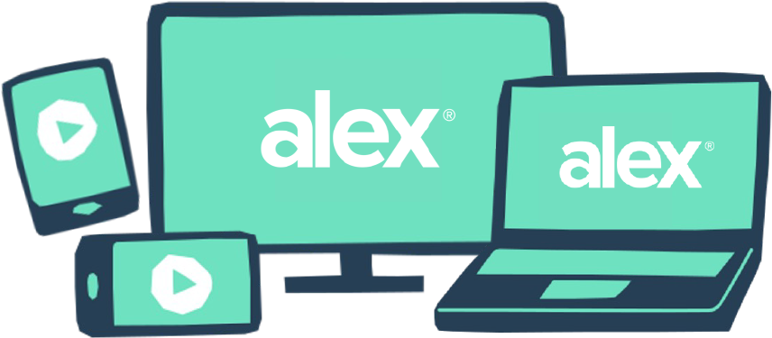
Want to know how your benefits changed from last year?
The next time you talk to ALEX, set up an ALEX ID first. An ALEX ID lets you save and revisit this year’s benefits recommendations and see how your best options might have changed next year when it’s time to enroll again.
Set up your ALEX ID now at <www.sampleURL.com>
QR CODE HERE
YOUR LOGO HERE

