Slide 1

Set sail for
Open Enrollment!
Note: You cannot use Museo Sans, our brand font, in Slides. If your team plans to create ads using templates, I would recommend finding a different layout tool. Otherwise, your work will always be slightly off-brand. As it stands, Montserrat is the font offered by Slides which is closest to Museo sans, and I set some type here to serve as an example.

Slide 2


Slide 3


Slide 4
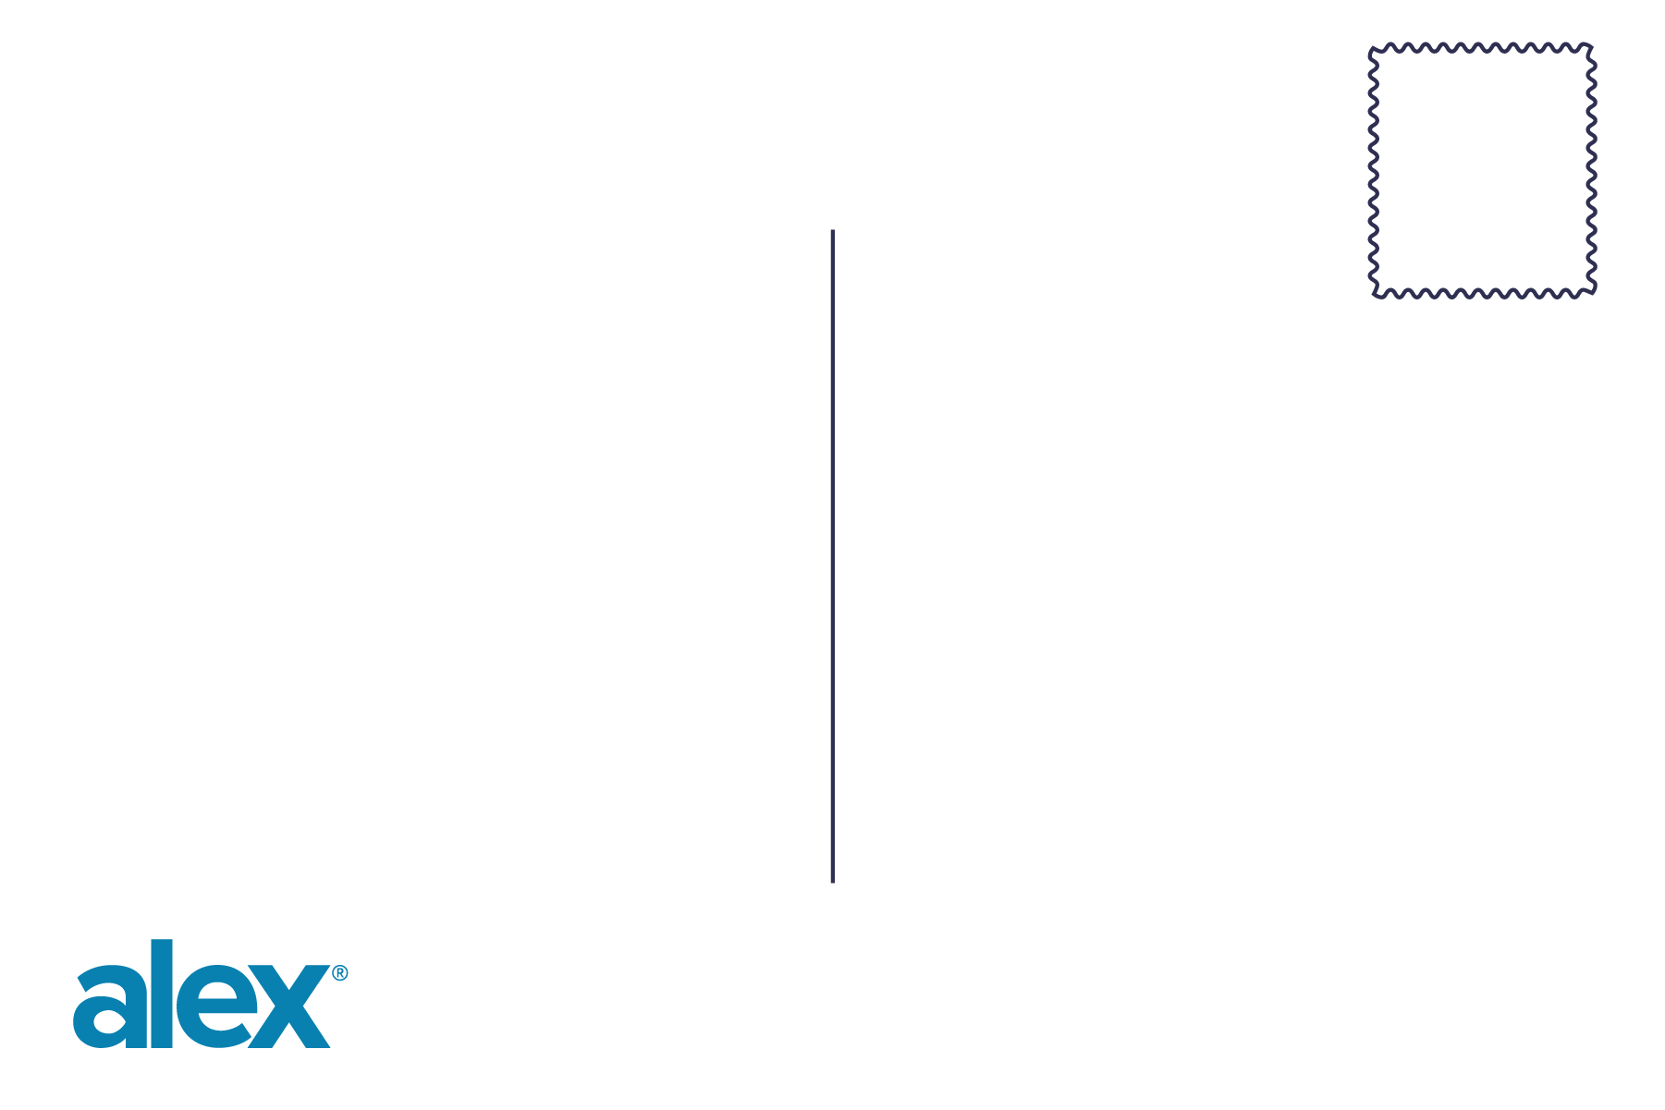
YOUR LOGO HERE

