Slide 1
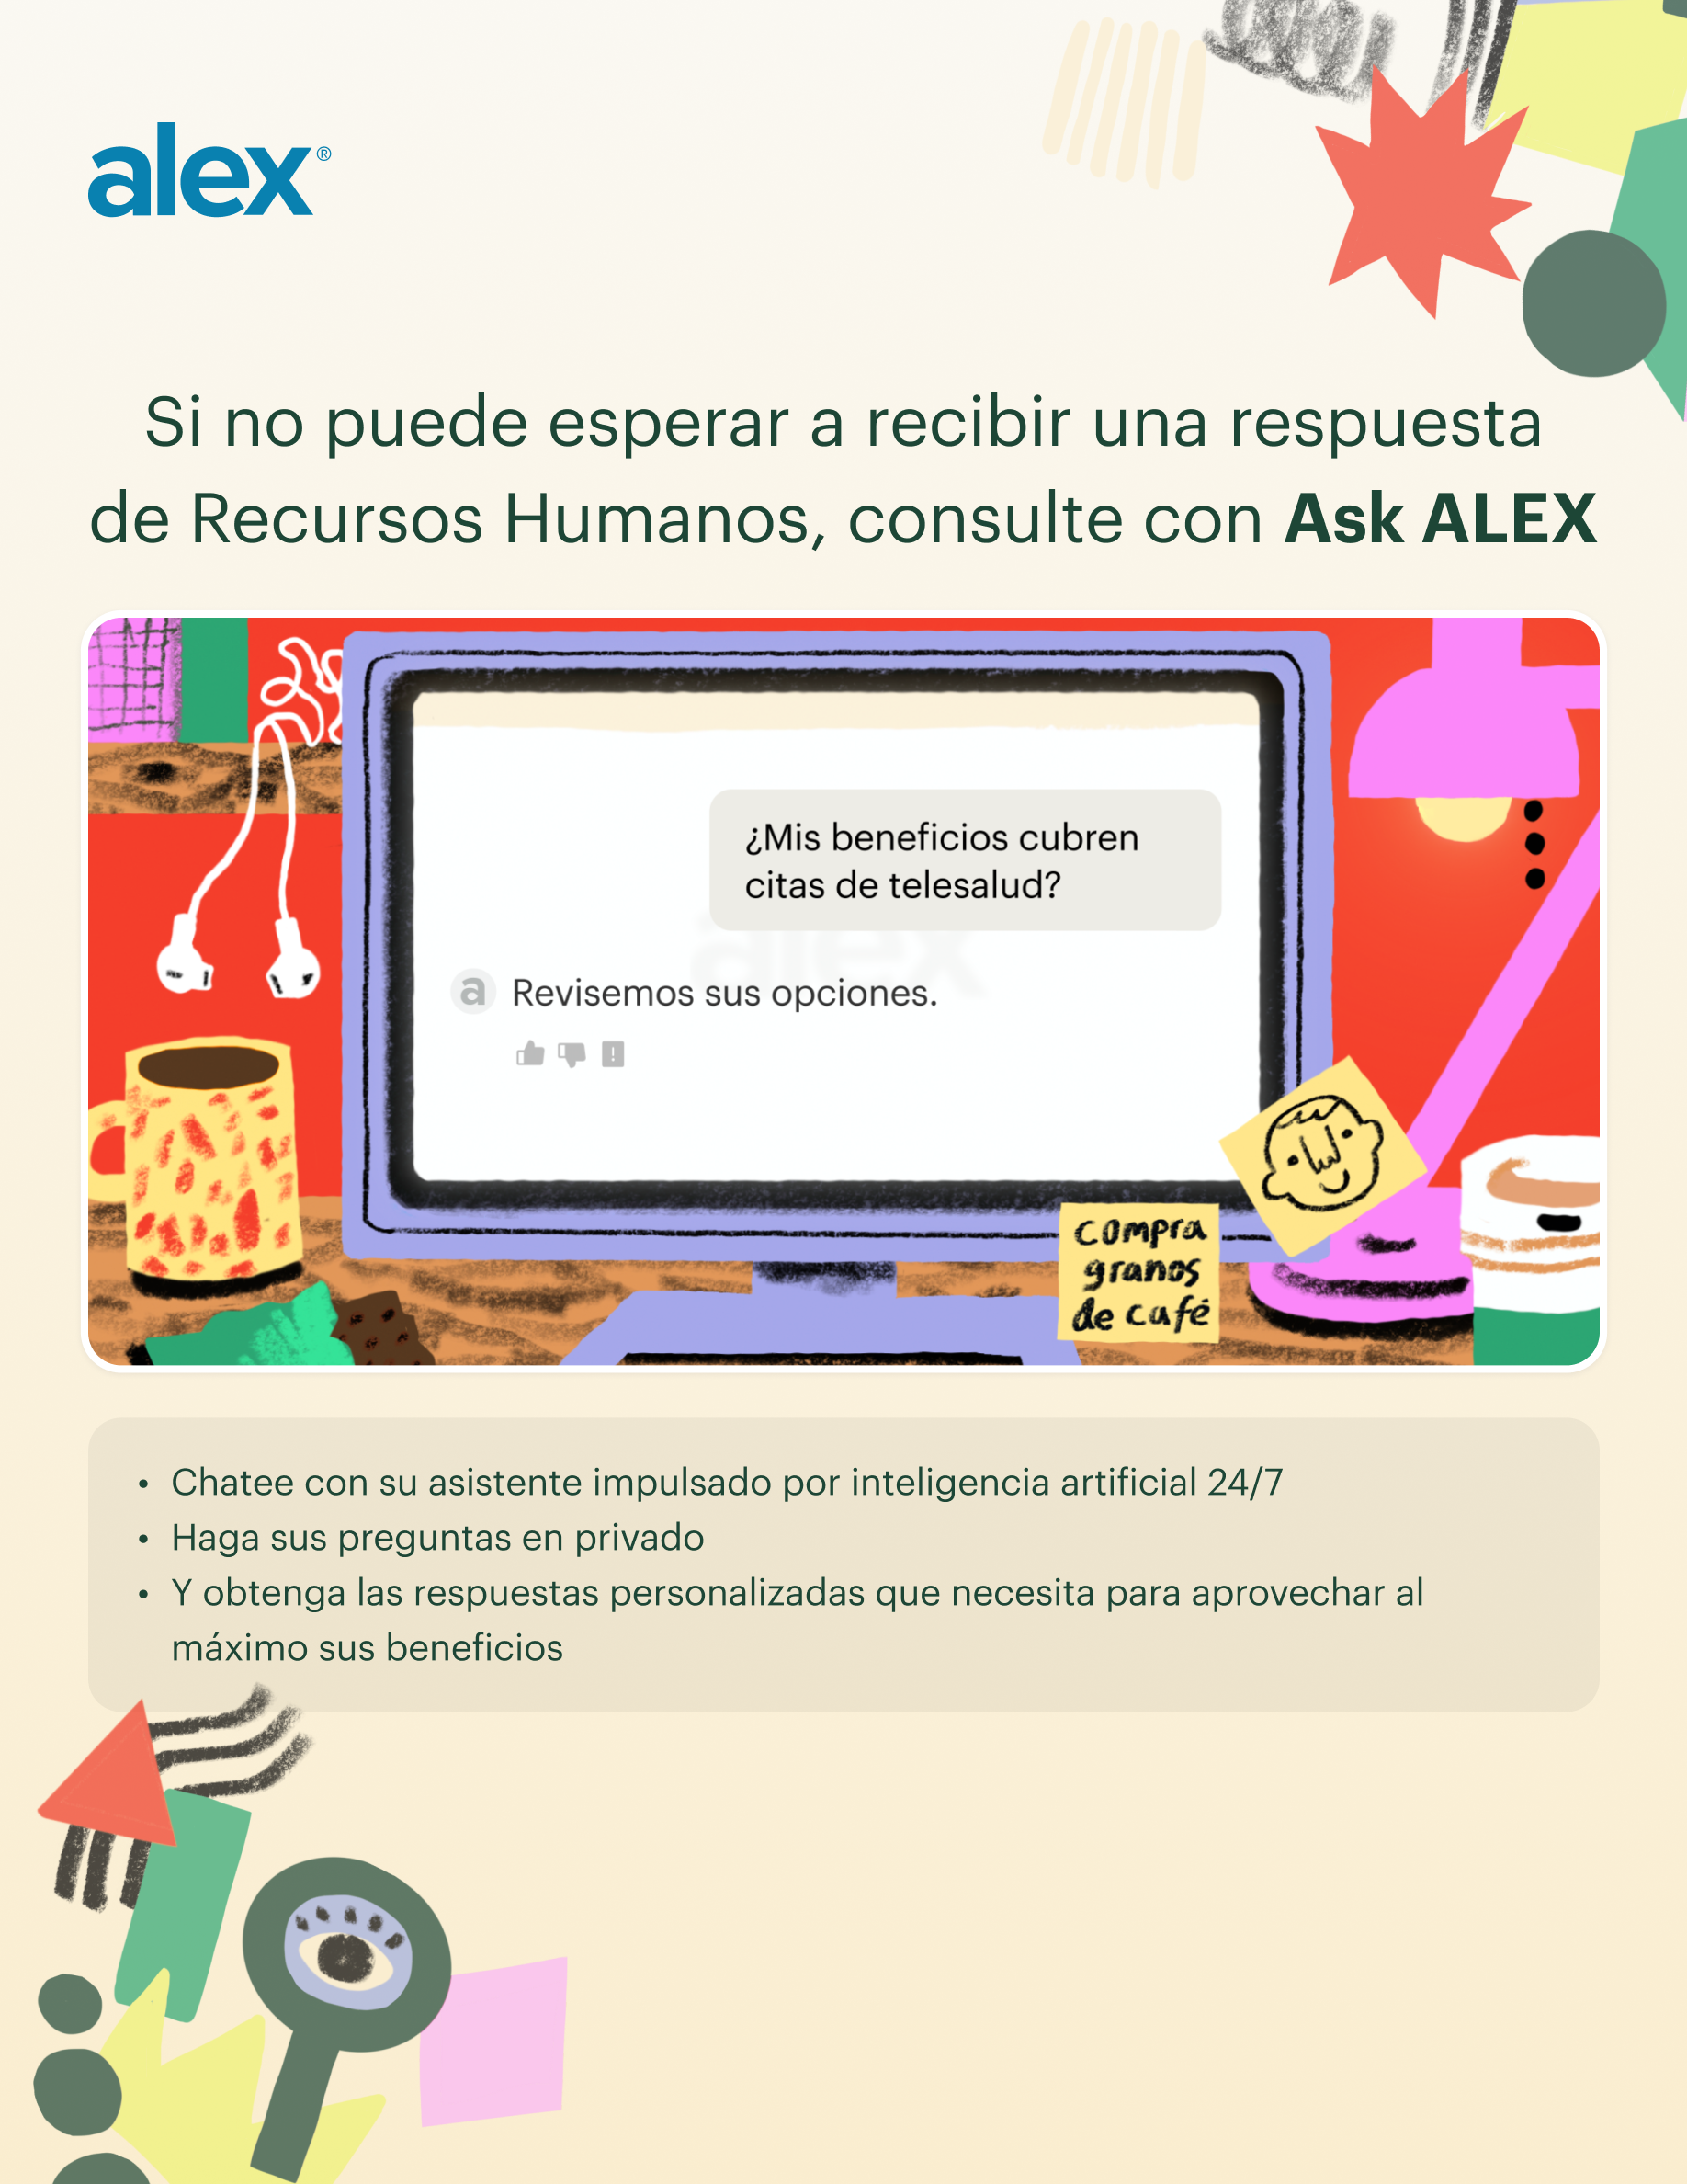

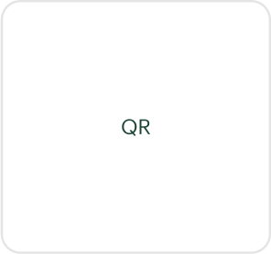
start.myalex.com/[Your ALEX URL]/ask-alex

